Slide 1

Standards-based CyberInfrastructure for HydroMeteorology (SCIHM): A collaborative project funded by the U.S. National Science Foundation and the European Union
U.S. Project Team:
National Center for Atmospheric Research
Consortium of Universities for the Advancement of Hydrologic Sciences, Inc.
San Diego Super Computing Center
Rutgers University

Slide 2
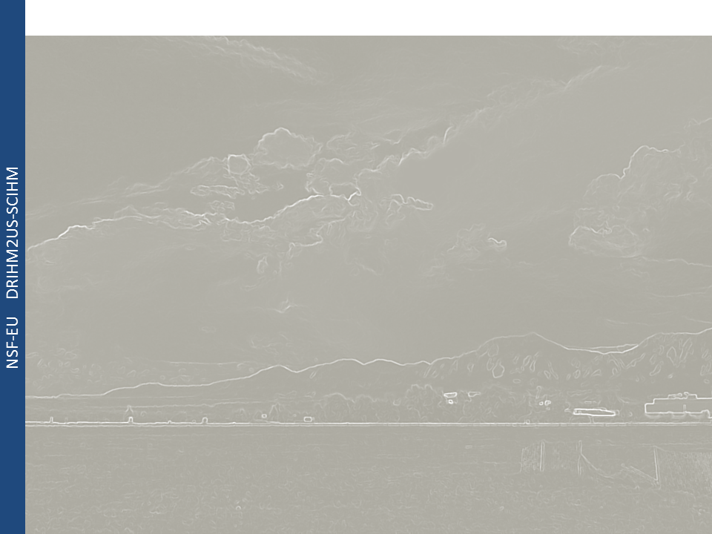
Challenges to Improving Predictions:
Background
Workflows
Models
Data
Computing
Use Cases
Scientific: Complexities of multiple physical processes occurring at a range of spatial and temporal scales require new approaches to predictive modeling of high impact hydrometeorological events
Cyberinfrastructure: Heterogeneous data structures and symantics limits efficient discovery, processing and ingest of critical environmental data. There is significant unrealized potential in distributed (cloud) computing resources for predictive modeling.

Slide 3
SCIHM Project Goals:
Background
Workflows
Models
Data
Computing
Use Cases
Overarching: Foster a standards-based hydrometeorological infrastructure where users can predict extreme weather events and their hydrological, environmental and societal impacts, taking advantage of scalable, on-demand high-performance cloud-based computational resources and shared data space
Specifically: Develop and deploy standards-based multi-layered infrastructure for dynamic distributed data to:
Discover, manage and integrate dynamic distributed data via standard service interfaces, and within a data grid environment
Link distributed data with high-resolution simulation models
Manage large computational problems on distributed high-performance computing architectures

Slide 4
Project Team:
Background
Workflows
Models
Data
Computing
Use Cases
Rick Hooper, CUASHI :
Shantenu Jha, Rutgers U. : Integrating standards-based compute and data cyber-infrastructure, e.g., SAGA-iRODS; interoperable XSEDE-PRACE solutions
Ilya Zavslosky, San Diego Super Computing Center :
David Gochis, National Center for Atmospheric Research : Hydrometeorologist, co-developer of WRF-Hydro system
Notes:
Add each person’s role…

Slide 5
Outline:
Background
Workflows
Models
Data
Computing
Use Cases
Background
Prediction System Workflows
Description of Computational Models
Standards-based Data Discovery and Processing
Utilizing High Performance Computing Capabilities
Prediction System Test Cases

Slide 6
Navigating Hydrometeorological Prediction Systems:
Background
Workflows
Models
Data
Computing
Use Cases
Past Met. Observations
Physio/Hydro-graphic Data
Met. Data Assim. Cycles
Past Streamflow
Meteorological
Analyses
Land/Hydro
Data Assimilation Model
QPN via Nowcast
Models
QPF via NWP
Models
Hydro Models
Obs. Streamflow
Ensemble Hydro-Prediction Products
Met. Observations
Forecast Verification

Slide 7
Navigating Hydrometeorological Prediction Systems:
Background
Workflows
Models
Data
Computing
Use Cases
Past Met. Observations
Physio/Hydro-graphic Data
Met. Data Assim. Cycles
Past Streamflow
Meteorological
Analyses
Land/Hydro
Data Assimilation Model
CRITICAL NEEDS & OPPORTUNITIES FOR
DATA DISCOVERY AND PROCESSING
QPN via Nowcast
Models
QPF via NWP
Models
Hydro Models
Obs. Streamflow
Ensemble Hydro-Prediction Products
Met. Observations
Forecast Verification

Slide 8
Navigating Hydrometeorological Prediction Systems:
Background
Workflows
Models
Data
Computing
Use Cases
Past Met. Observations
Physio/Hydro-graphic Data
Met. Data Assim. Cycles
Past Streamflow
Meteorological
Analyses
Land/Hydro
Data Assimilation Model
QPN via Nowcast
Models
QPF via NWP
Models
CRITICAL NEEDS & OPPORTUNITIES FOR
HIGH PERFORMANCE COMPUTING
Hydro Models
Obs. Streamflow
Ensemble Hydro-Prediction Products
Met. Observations
Forecast Verification

Slide 9
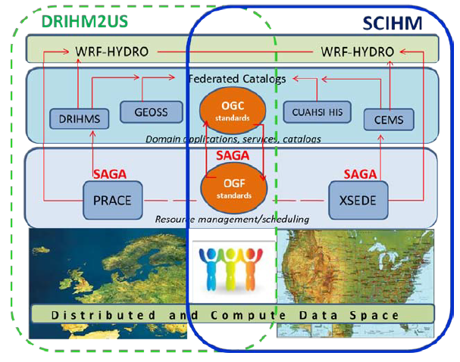
U.S. – E.U. Data and C-I Integration:
Background
Workflows
Models
Data
Computing
Use Cases

Slide 10
Description of Models:
Background
Workflows
Models
Data
Computing
Use Cases
Meteorological Modeling Systems
Hydrological Modeling Systems
Weather Research and Forecasting Model (WRF):
Non-hydrostatic regional model
Multiple physics options
Modestly extensible
Complete but ‘limited’ suite of pre/post processors
High-performance computing enabled, moderately portable
WRF-Hydro modeling system:
Model coupler for various column and routing physics components
Multiple physics options
Multi-scale capabilities
High-performance computing enabled, moderately portable
CSDMS via EarthCube project
More general surface dynamics coupling framework
Limited portability at present

Slide 11
WRF-Hydro System:
Background
Workflows
Models
Data
Computing
Use Cases
Multi-scale/Multi-physics modeling…
Gridded
Forcing
Data
Nowcast,
Weather and Climate
Models
Exploration of other ‘standards-based’ coupling architectures:
e.g. CCA-CSDMS, ESMF
NDHMS Driver/Coupler
w/ conservative regridders
Land &
Hydro
Data
Assimilation
Column
Land
Surface
Model
Subsurface
Flow
Routing
Channel &
Overland
Flow
Routing
Water
Management

Slide 12
Data Discovery and Processing:
Background
Workflows
Models
Data
Computing
Use Cases
Ilya
Main goal
Main tools/capabilities:
HIS databases
OGC standards

Slide 13
High Performance Computing Job Managment:
Background
Workflows
Models
Data
Computing
Use Cases
Shantenu: Leads team of 2 Graduate Students (Mark, Ashley), 1 undergraduate researcher (Vishal)
See http://radical.rutgers.edu/people
Main Goal: (i) Developing iRODS-SAGA adaptors to provide standards-based and integrated compute-data CI; (ii) Enabling data-intensive high-performance, high-throughput ensemble simulations on XSEDE and PRACE
Main tools/capabilities:
SAGA [http://saga-project.org]
SAGA-SLURM, SAGA-SGE and SAGA-BES(?) SAGA-iRODS
BigJob [https://github.com/saga-project/BigJob/wiki]

Slide 14
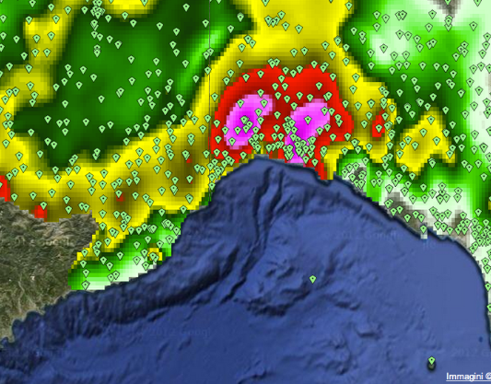
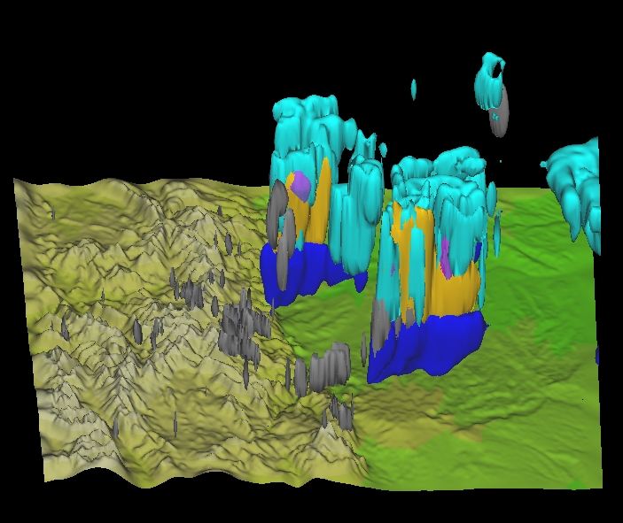
Description of Use Cases:
Background
Workflows
Models
Data
Computing
Use Cases
Synoptically-forced Extreme
Flood: Genoa, Italy
Isolated Heavy-rainfall Flash Flood Event: Colorado Mountain Front
> 450mm in 8 hrs
Event occurred over steep coastal Appenine Mountains
Several perished and millions of Euros in damage
> 25 mm in 1 hr with instanteous rates > 100mm/hr
Event occurred on previous forest fire burn in steep terrain
Large debris flow

Slide 15
Project Timeline:
Background
Workflows
Models
Data
Computing
Use Cases
Project Activities | Year 1 |  |  |  | Year 2
 | Q1 | Q2 | Q3 | Q4 | Q1 | Q2 | Q3 | Q4
1.Modeling CI
2. Service and catalog interoperability
3. Compute and data management infrastructure
4. System testing |  |  |  |  |  | X
5 Community engagement |  |  | X |  |  |  | X
Joint EU-US Project Meetings | X |  |  |  | X
US Project Meetings |  |  | X |  |  | X

Slide 16
End
Background
Workflows
Models
Data
Computing
Use Cases

